Slide 1
Welcome

Slide 2
INTRODUCING
Teacher introducing
Class introducing
Asst. Teacher
Bidyut kumar Deb
Bania Bazar High School
Jamal pur sadar
Jamalpur
Class:7 Sec: A
Subject: English 1st paper
Topics: Great women to remember
Time:50minutes

Slide 3
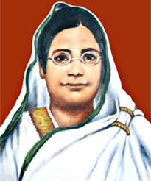
Look at the pictures

Slide 4
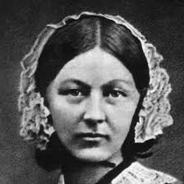
Look at the picture

Slide 5
Learning outcomes
We will be able to
Ask and questions
Talk about people
Read and understand texts
Write answers to questions
Write short paragraphs and compositions.

Slide 6
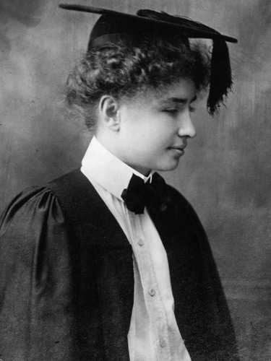
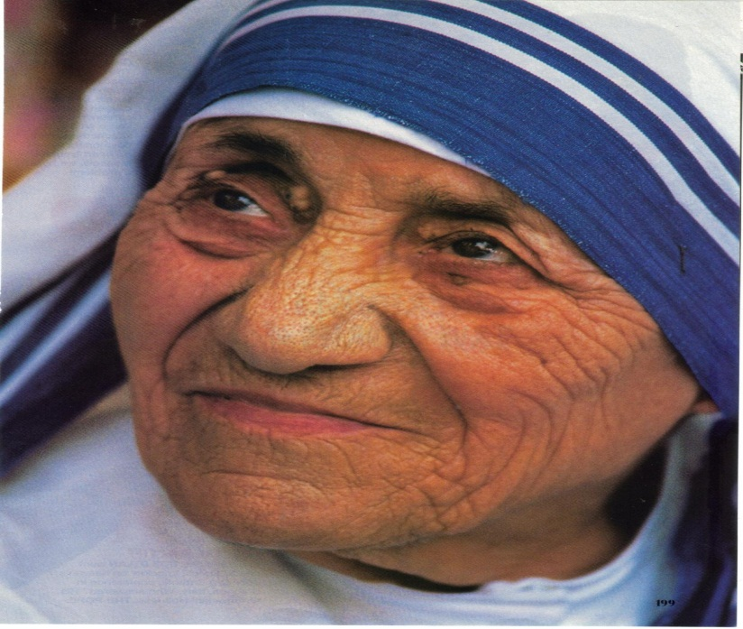
Vocabulary
Humanitarian
making people’s sufferings less and improving their living condition

Slide 7
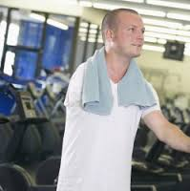
Disabled
unable to use a part of the body

Slide 8
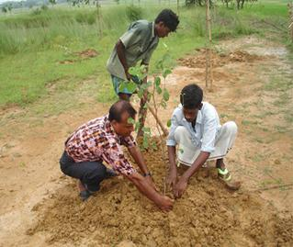
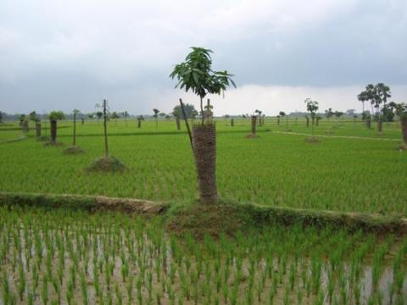
Plantation
a large area of land where crops like sugar, banana, etc.are grown

Slide 9
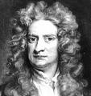
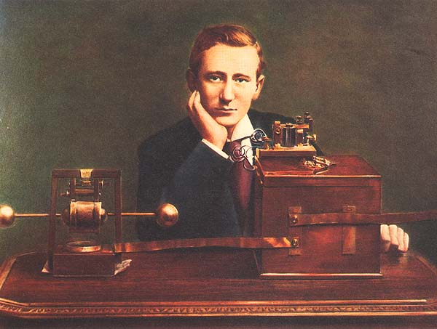
Inventor
a person who has discovered some thing new.
Make sentence with the above words.

Slide 10
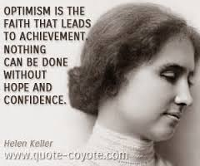
Our Text Here
Open your book
Unit:5 lesson:3
Page:44
Read the passage

Slide 11
Group work
Write your answer in your exercise book
1.Who was Helen keller?
2.Whom did he work?
3.What was the condition of her family?
4.Who was Michel Anagonas?

Slide 12
Pair work
Answer the following questions in pairs
1.Whom did Helen Keller work?
2.When and where was she born?
3.Who was Captain Arther keller?
4.How did Helen keller become blind?

Slide 13
Evaluation
Answer the following questions
What was Helen’s father?
When was she born?
Who was Grahambell?
What is perkins shool?

Slide 14
Home work
Write a paragraph about Helen keller

Slide 15
Good bye

